Slide 1
OPERATION & METRIC ANALYTICS
Swagatika Samal

Slide 2


Agenda
A
Problem Statement
Tech Stack Used
DataSet Used
Approach
Insights
Summary

Slide 3
PROBLEM STATEMENT
Assuming myself as a Lead data analyst, I will be working with company like Microsoft.
Operational Analytics is a crucial process that involves analyzing a company's end-to-end operations. This analysis helps identify areas for improvement within the company.
I have been provided with various datasets and tables, and my task is to derive insights from this data to answer questions posed by different departments within the company. I have used advanced SQL skills to analyze the data and provide valuable insights that can help improve the company's operations and understand sudden changes in key metrics.

Slide 4
TECH STACK USED
I have used MySQL Workbench 8.0 to execute the project.
I have also used Microsoft Power Point to prepare presentation for the project.

Slide 5
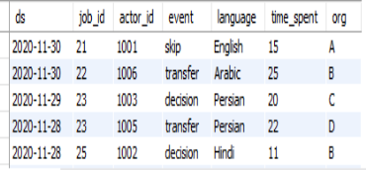
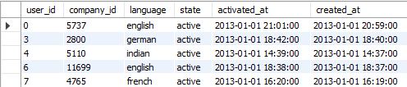
DATASET USED
I have created a Project3 database to do job data analysis & metric spike investigation. The screenshot for the tables have been shared below.
job_data
users

Slide 6
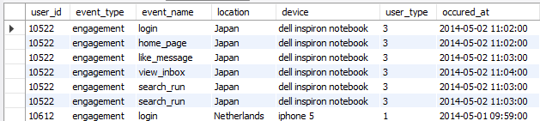
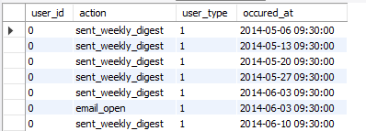
DATASET USED
I have created a Project3 database to do job data analysis & metric spike investigation. The screenshot for the tables have been shared below.
events
email_events

Slide 7
APPROACH
Firstly I created the required tables by importing data from .csv file using command ‘load data infile’. Then following queries were resolved:
JOB DATA ANALYSIS:
Calculate the number of jobs reviewed per hour for each day in November 2020.
Calculate the 7-day rolling average of throughput.
Calculate the percentage share of each language over the last 30 days.
Display duplicate rows from the job_data table.

Slide 8
APPROACH
METRIC SPIKE INVESTIGATION:
Calculate the weekly user engagement.
Calculate the user growth for the product.
Calculate the weekly retention of users based on their sign-up cohort.
Calculate the weekly engagement per device.
Calculate the email engagement metrics.

Slide 9
DATA SET USED
I have used MySQL Workbench 8.0 to execute the project.
I have also used Microsoft Power Point to prepare presentation for the project.

Slide 10
JOB DATA ANALYSIS

Slide 11
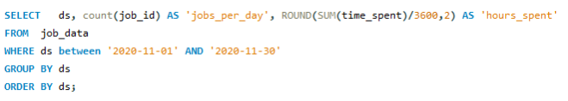
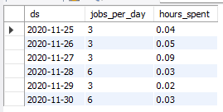
Calculate the number of jobs reviewed per hour for each day in November 2020.
Query
Result

Slide 12
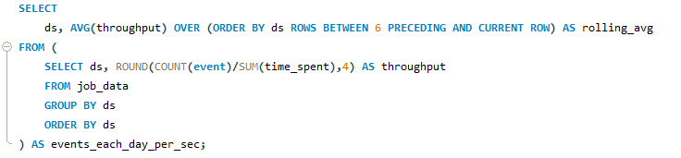
Calculate the 7-day rolling average of throughput (number of events per second).
Query
Result

Slide 13
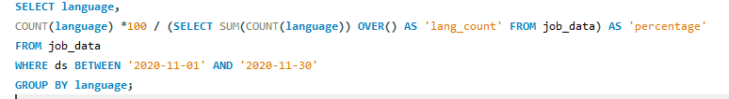
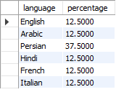
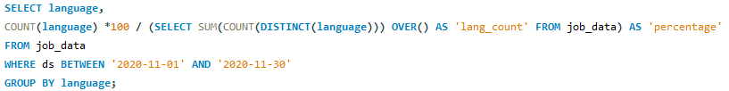
Calculate the percentage share of each language in the last 30 days.
Query
Result

Slide 14
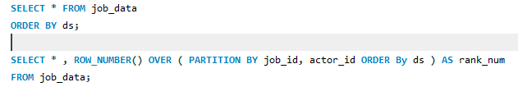
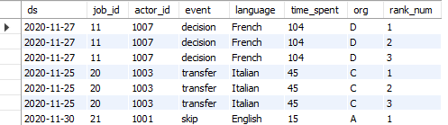
Display duplicate rows from the job_data table.
Query
Result

Slide 15
METRIC SPIKE INVESTIGATION

Slide 16
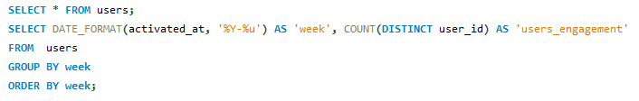
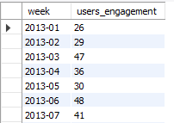
Calculate the weekly user engagement.
Query
Result

Slide 17
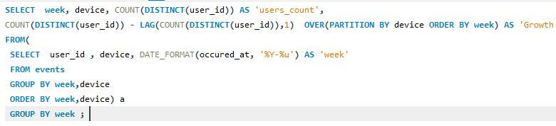
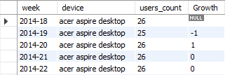
Calculate the user growth for the product.
Query
Result

Slide 18
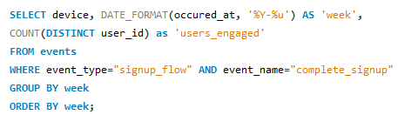
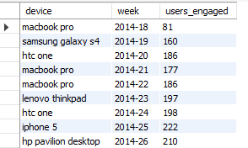
Calculate the weekly retention of users based on their sign-up cohort.
Query
Result

Slide 19

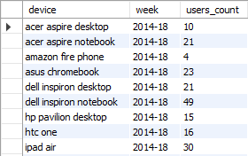
Calculate the weekly engagement per device.
Query
Result

Slide 20
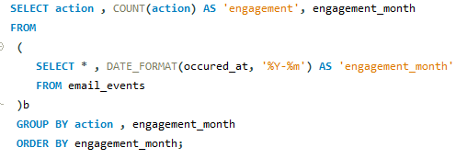
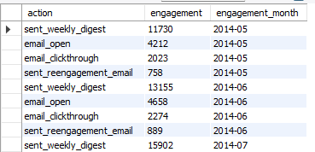
Calculate the email engagement metrics.
Query
Result

Slide 21
INSIGHTS
Through the Job Data Analysis, I have summarized that the daily and hourly analysis of the number of jobs reviewed reveals varying levels of activity, with certain days exhibiting higher engagement and others experiencing lower levels. The 7-day rolling average provides a smoothed perspective of the data, highlighting overall trends amid daily fluctuations. Furthermore, the language distribution indicates that Persian holds the highest percentage. Conducting a thorough investigation into duplicate rows proves instrumental in ensuring data validation and accuracy.
Working on this project, I also gained major insights from Metric Spike Investigation which is demonstrated in the upcoming slides.

Slide 22
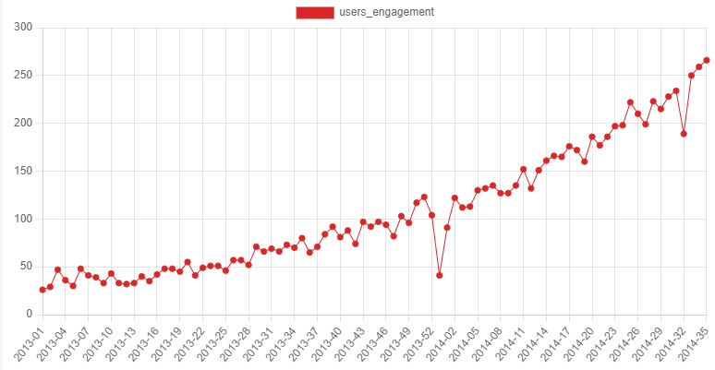
Weekly User Engagement
The graph depicts
more users engagement
In the year 2014 than
year 2013. So, we can
steady increase.

Slide 23
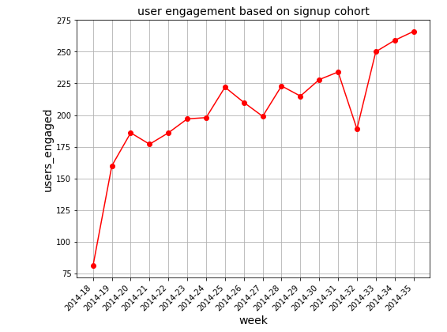
User Engagement Based on Sign-up Cohort
Here, we can see there is a
sudden spike of user
engagement from 18th to 19th
week.
Then there is steady increase
or decrease and then there is
sudden decrease in week 33
and then constant increase.

Slide 24
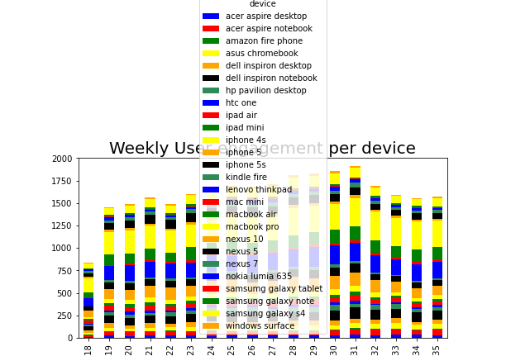
Weekly User Engagement per Device
The figure depicts users are mostly
engaged through their macbook
pro in the 31st week.

Slide 25
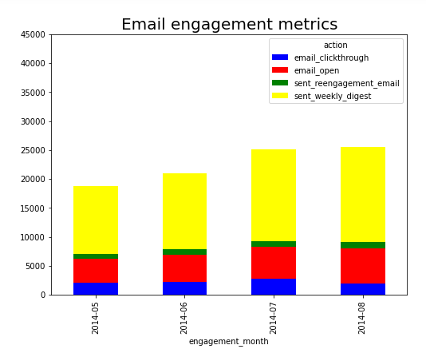
Monthly Email engagement
The figure depicts users are mostly
engaged through weekly digest. Other
actions doesn’t attract users.

Slide 26
SUMMARY
F
This project helped me to work with real time data and gather insights from the data which can meet business requirements.
Also I got an extensive hands on experience in working with SQL workbench.

